Slide 1
Cyber
Security
THAILAND

Slide 2




Cloud
SECURITY
Intensive

Slide 3





.1
Prerequistics
Learn.Microsoft.com Account
M365 Account
Entra ID P1/P2 Trials
Azure Free Account
Defender Trials

Slide 4
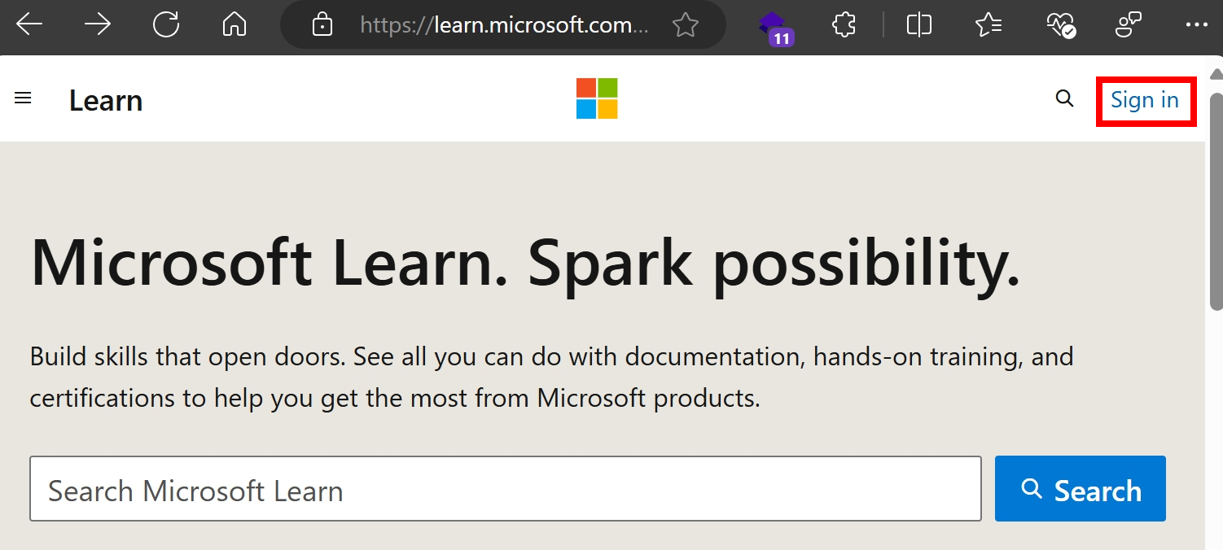




.Microsoft
.com
Learn.Microsoft.com/
Security
Zero-Trust
SecOps/SOC
Identity & Access (IAM)
Governance
and Compliance

Slide 5
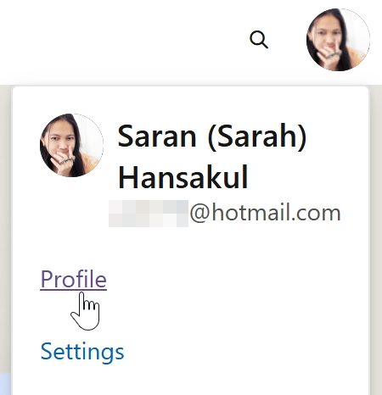
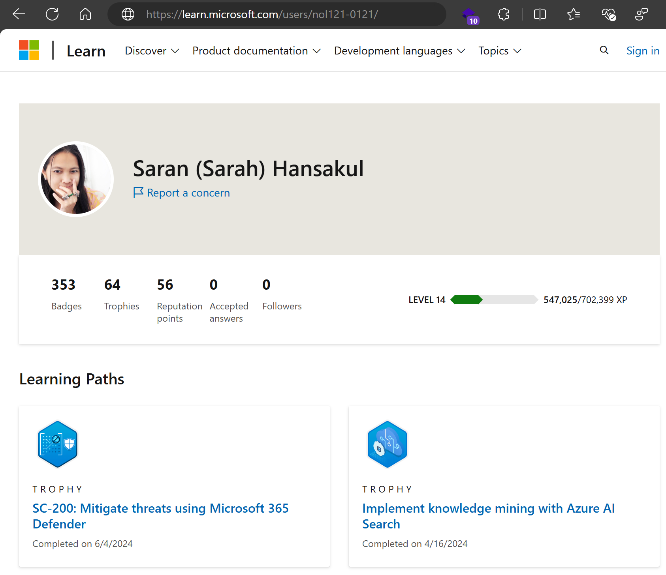
.Microsoft
.com
Get public profile to share learning progress:
Learn.Microsoft.com/Users/…

Slide 6
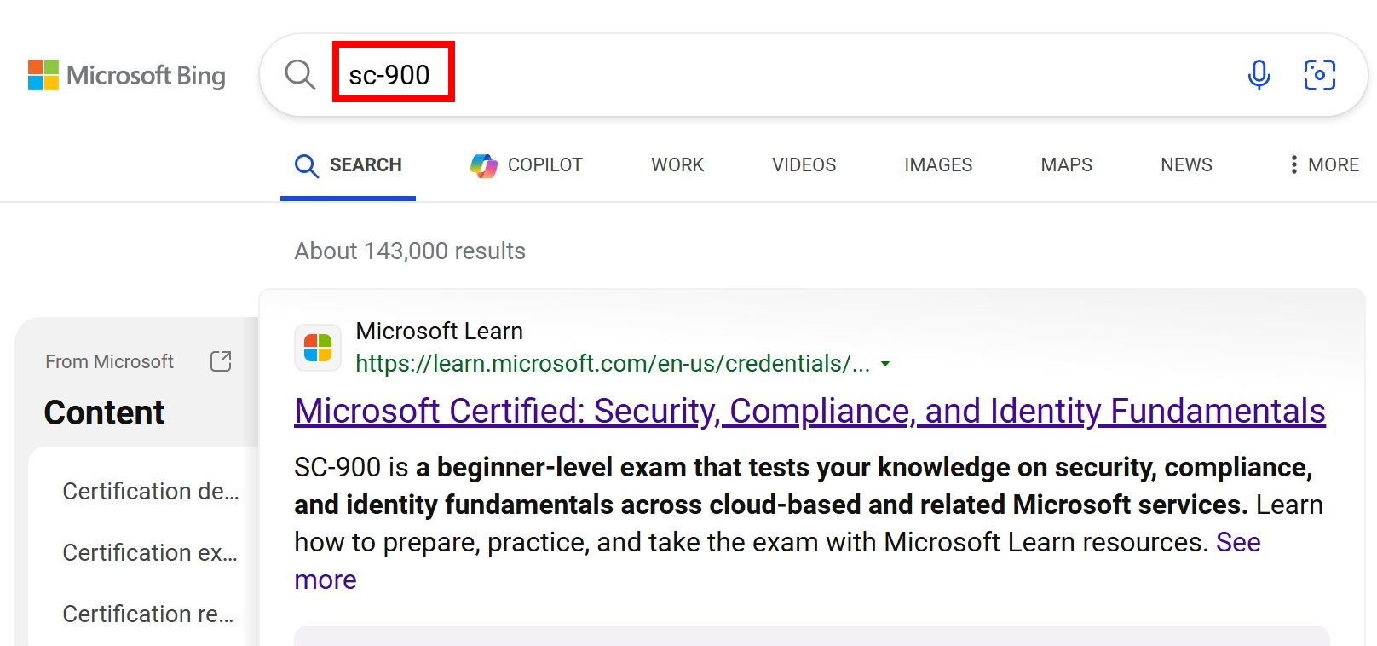
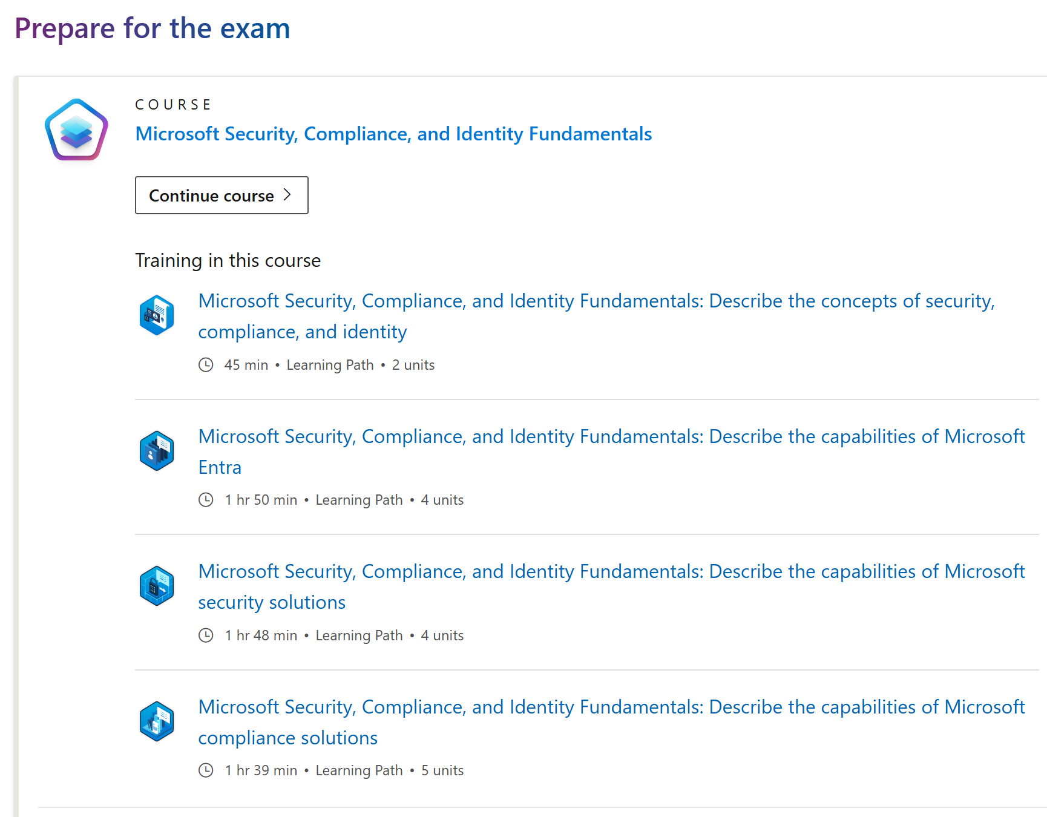
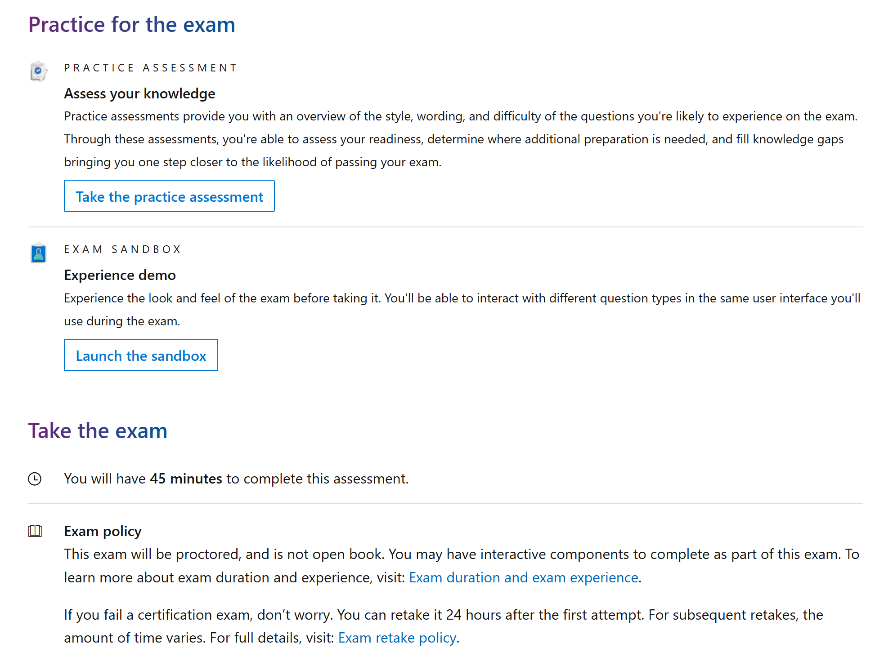
.Microsoft
.com
Browse lists of on-demand self-learning modules
Search with exam code
Mock-up exam with realistic environment

Slide 7
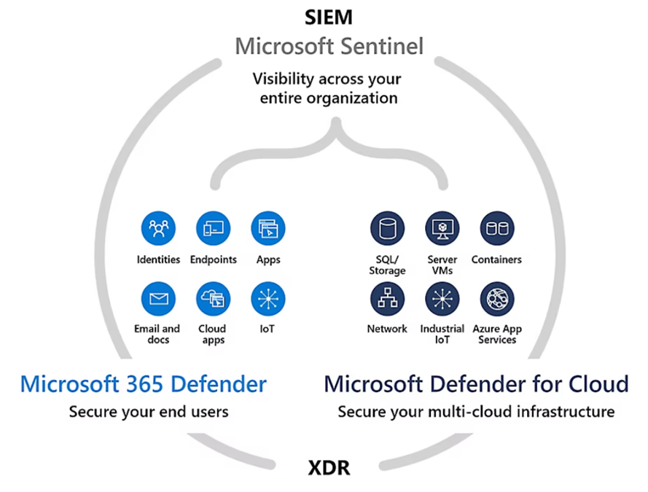
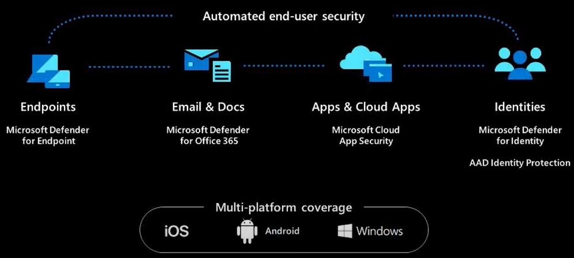
Why MS Cloud Sec needs:
M365
365 Defender

Slide 8
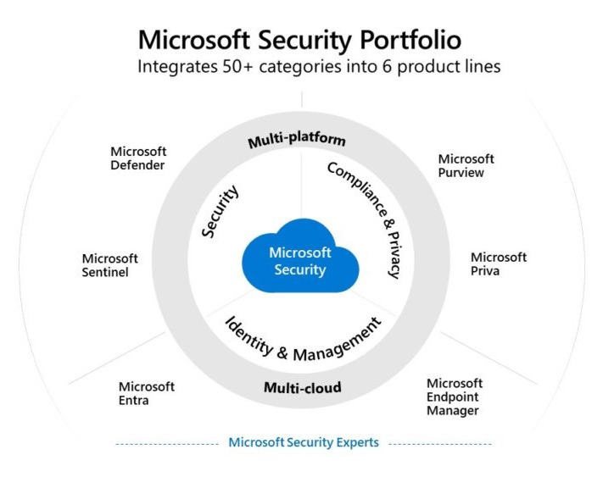
Why MS Cloud Sec needs:
M365
365 Defender

Slide 9
















Tend to be centralize more
Improved to be for “multi” Cloud/Platforms
Why MS Cloud Sec needs:
M365
365 Defender
M365
AZURE
Old Name
security.microsoft.com
portal.azure.com
New Name
MS Threat Protection
Defender XDR
Entra ID
Azure AD
365 Defender
entra.microsoft.com
Azure ATP
MDI
for Identities
MS Defender ATP
MDE
for Endpoint
Network Security
Office 365 ATP
MDO
for Office 365
for Cloud Apps
Defender for Cloud
Azure Defender
MS Cloud App Sec (MCAS)
MDCA
(CASB)
Cloud Security Posture Management (CSPM)
purview.microsoft.com
Azure Security Center
365 Compliance
Purview
(CWP) Defender for Server/Storage/SQL/etc.
Compliance.Microsoft.com
Sentinel
intune.microsoft.com
Endpoint.Microsoft.com
Intune
(Endpoint Manager)

Slide 10


Business
(Limit 300 users)
Basic
Online Apps
M365
Standard
+ Installed Apps
LICENSES
Premium
+ MDB + MDO
+ Basic DLP + Entra ID P1 (CA)
Enterprise
E3
+ MDE P1
E5
+ MDE P2 + Purview Complete
+ Entra ID P2 (PIM)

Slide 11
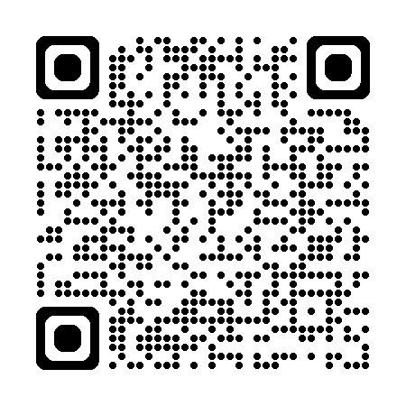
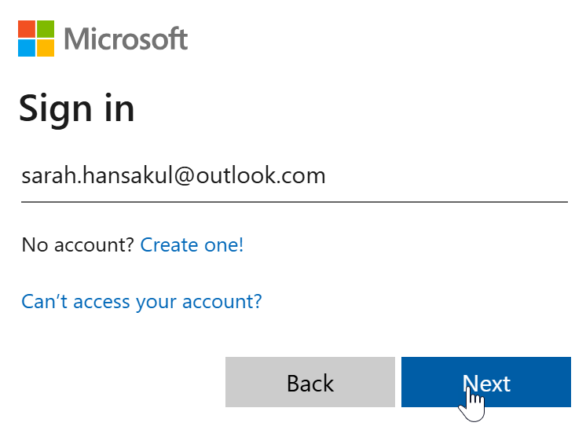
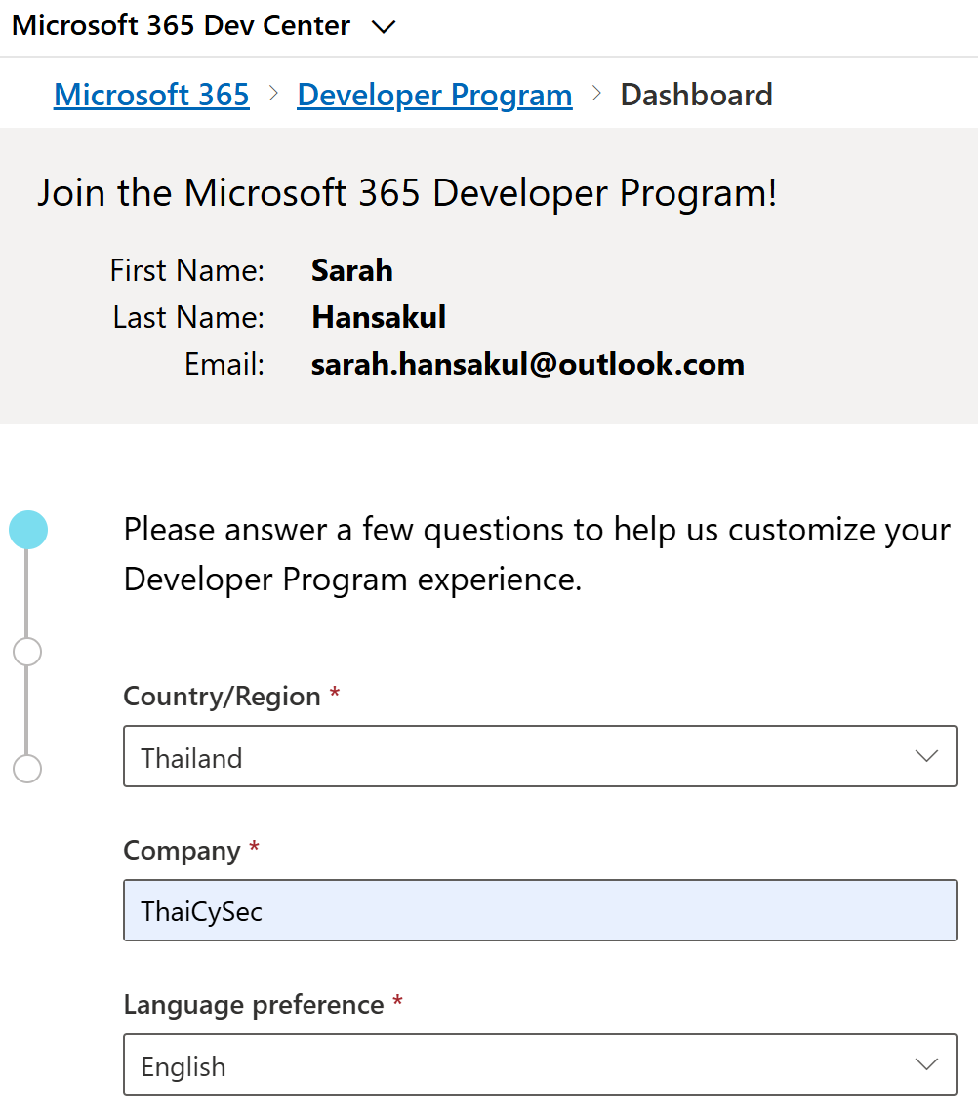
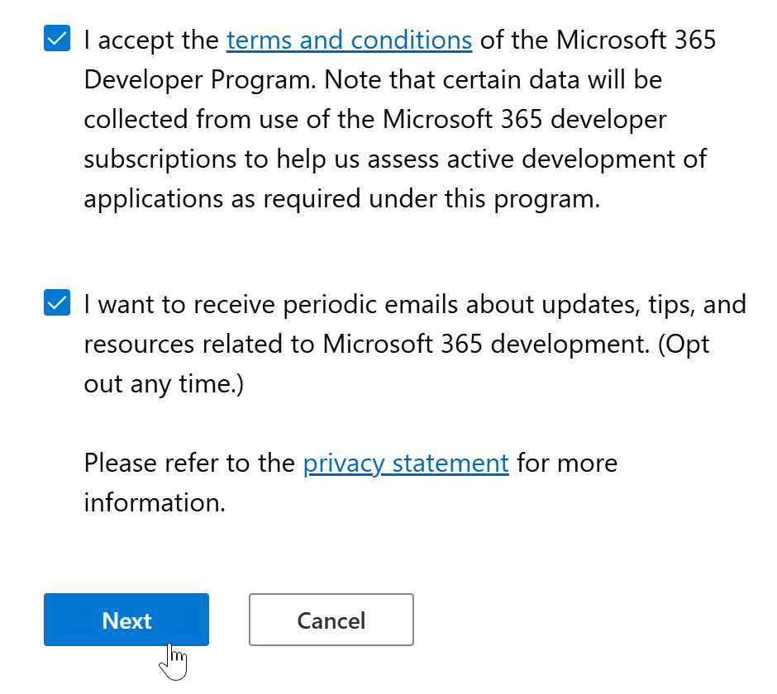
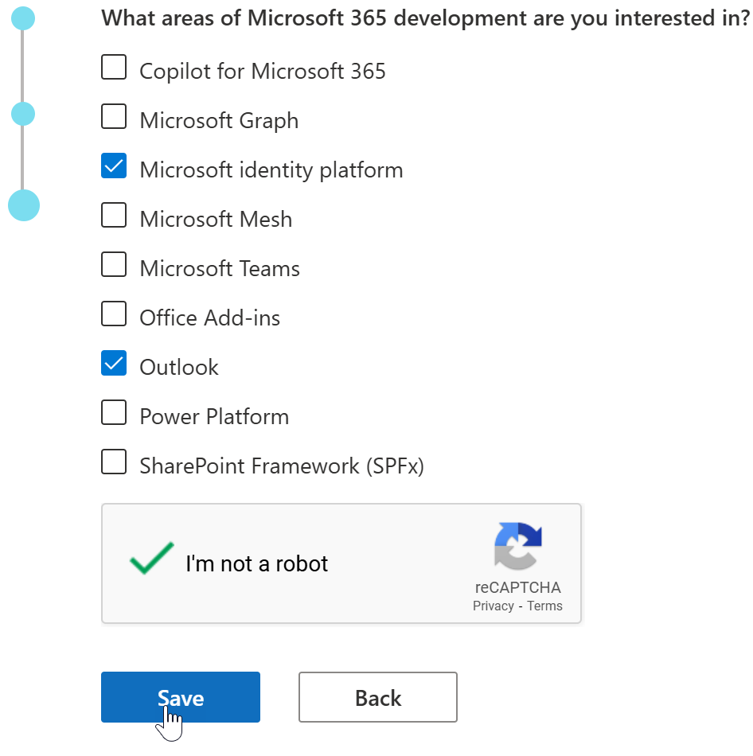
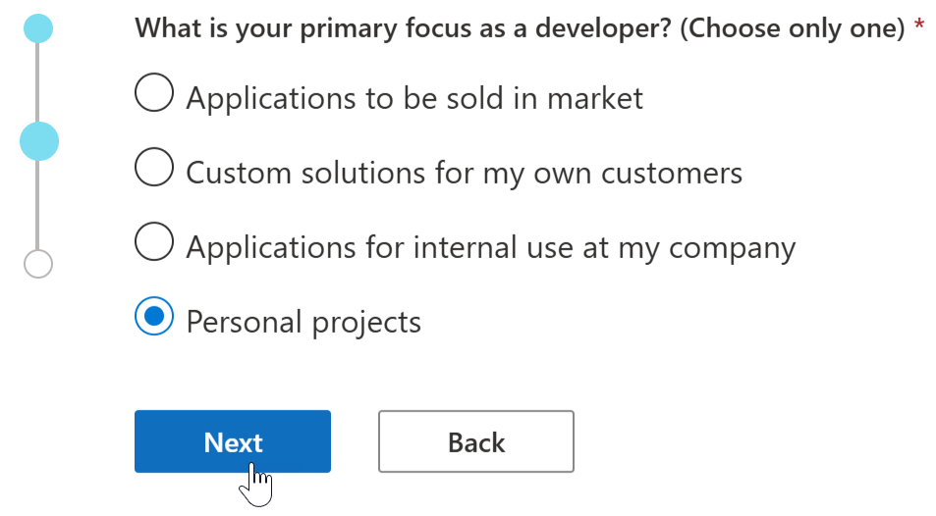
M365
Case I
FREE
Developer Account
If MCT,etc.
developer.microsoft.com
/microsoft-365/profile
Use qualified personal mail

Slide 12
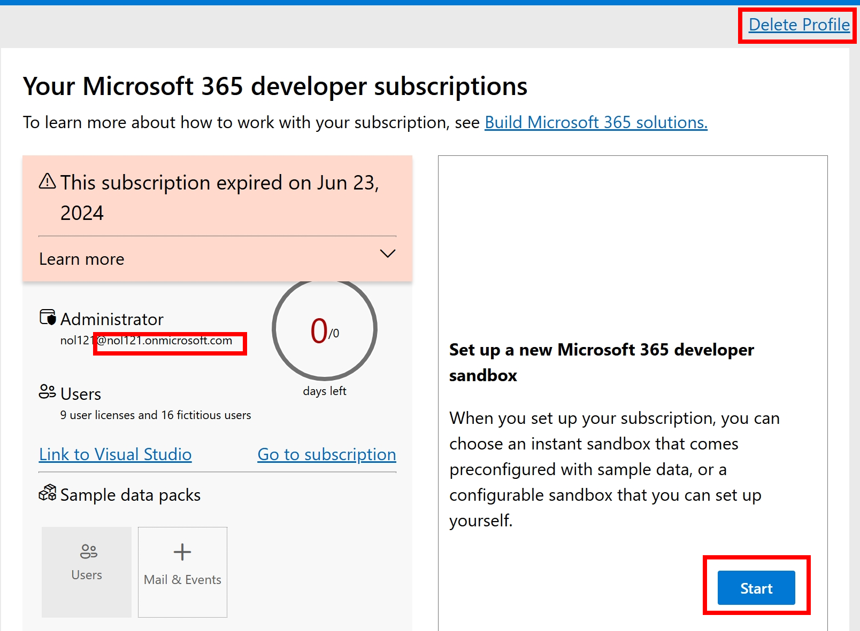
M365
Case I
Or ask your Partner if you have rights.
FREE
Developer Account
If MCT,etc.
developer.microsoft.com
/microsoft-365/profile
Delete old tenant/sandbox to create new
Get “random” @xxx.onmicrosoft.com
Keep active to be continuing use
Start new sandbox

Slide 13
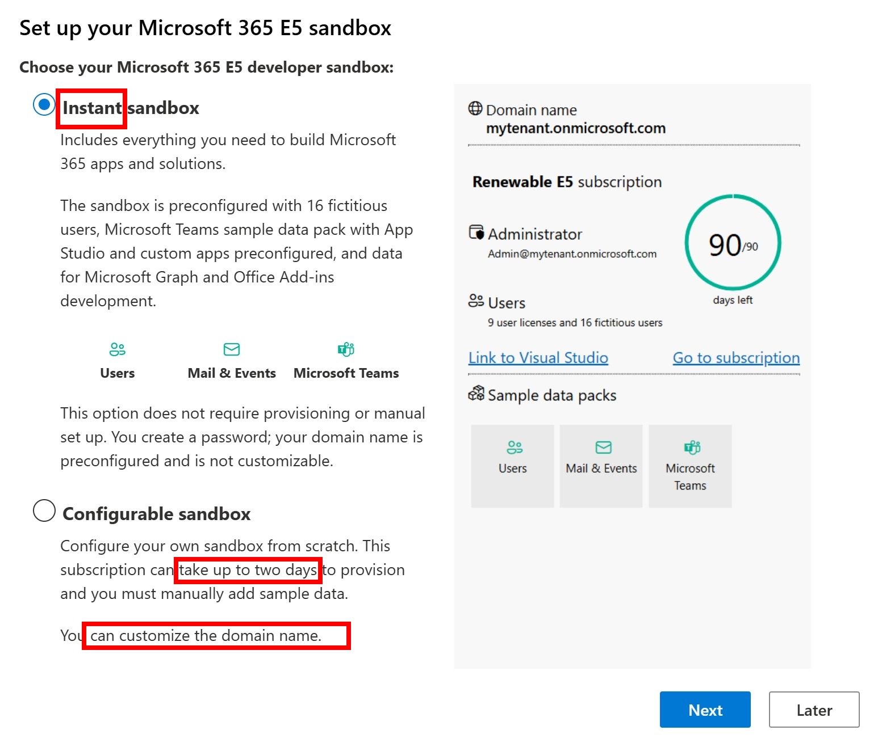
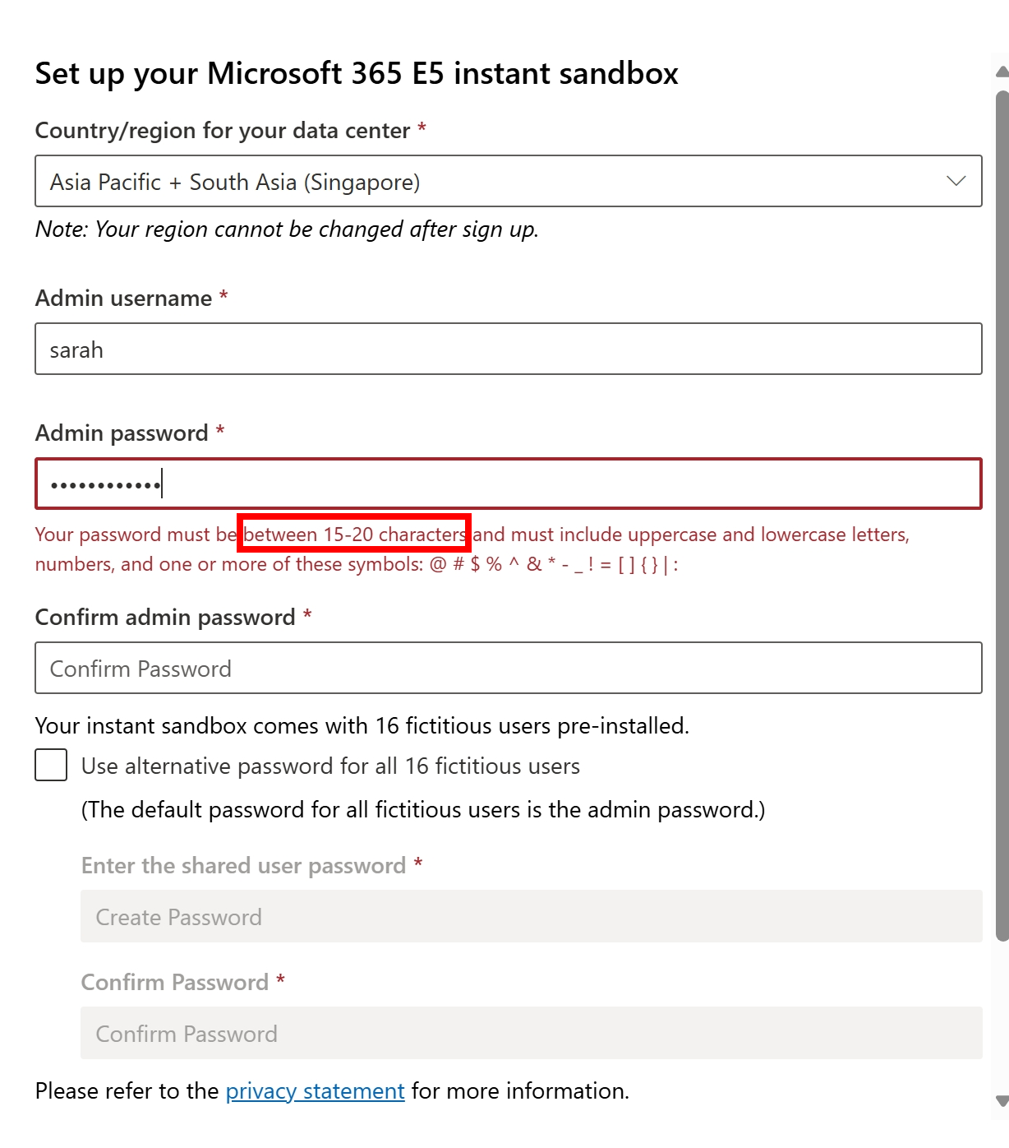
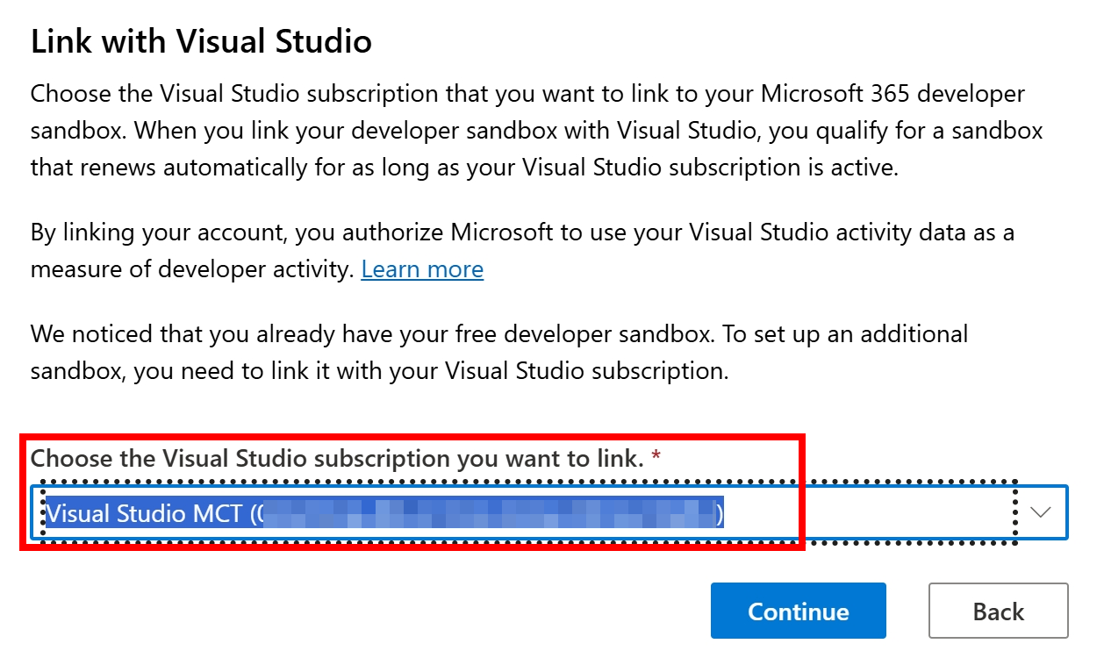
M365
Case I
FREE
Developer Account
If MCT,etc.
Recommend for temporary labs
Require complex password (15 chars++)
For prolonged experiment. You can continue using if you can keep it active and still having rights (MCT,etc.)

Slide 14
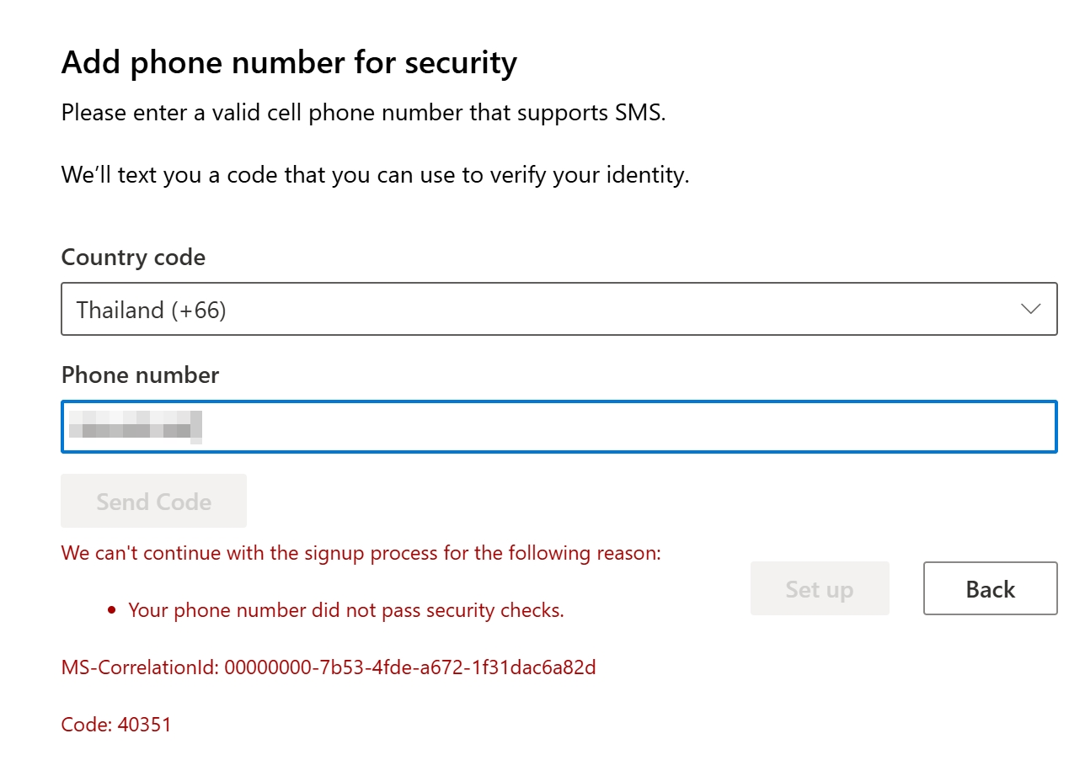
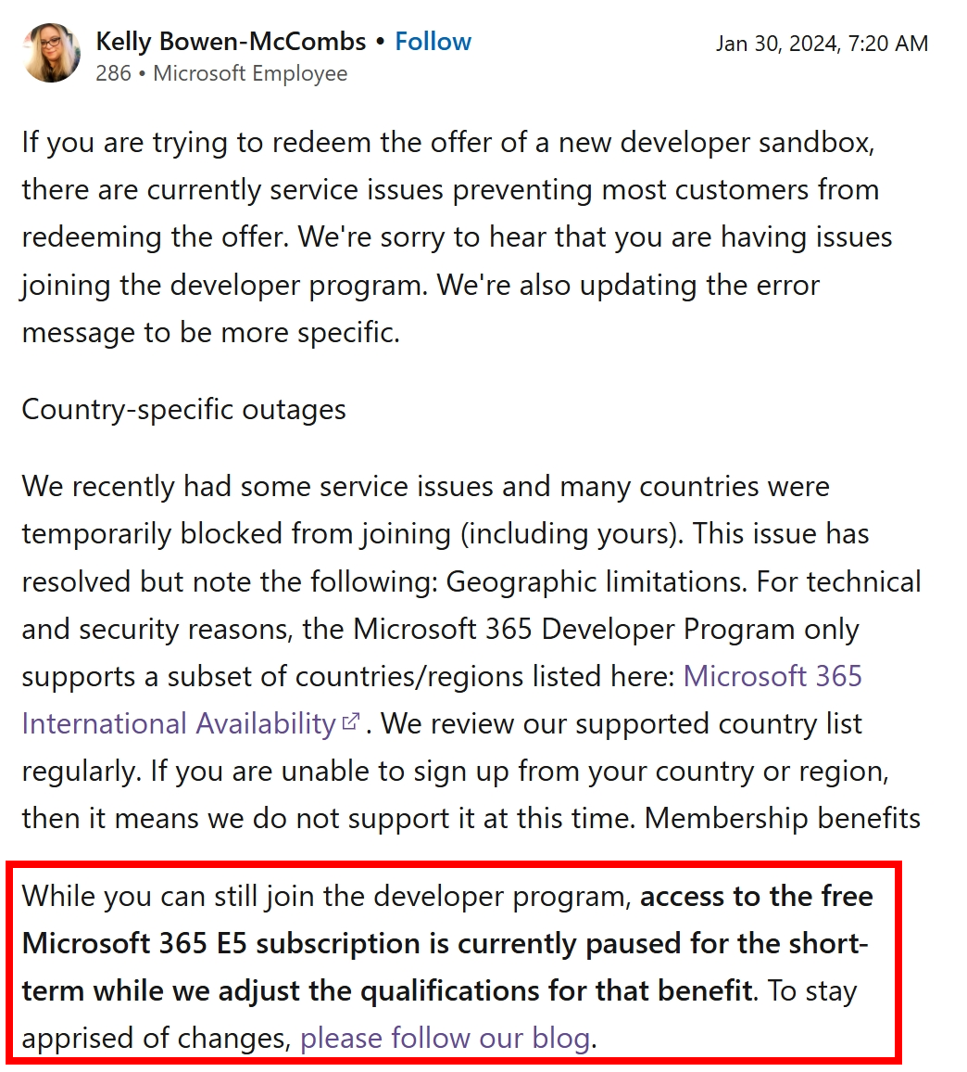
M365
Case I
FREE
Developer Account
If MCT,etc.
developer.microsoft.com
/microsoft-365/profile
Do not use same phone numbers that used to use
If error persists, go to Case II, apply E3 trial.

Slide 15
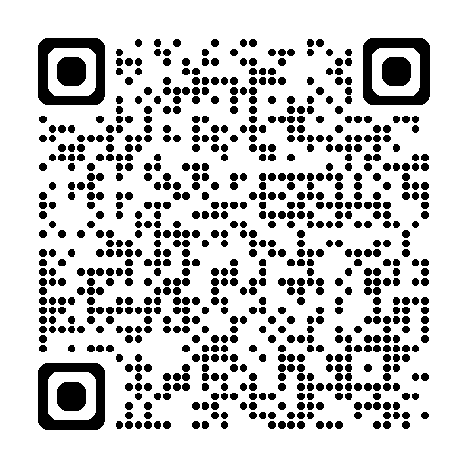
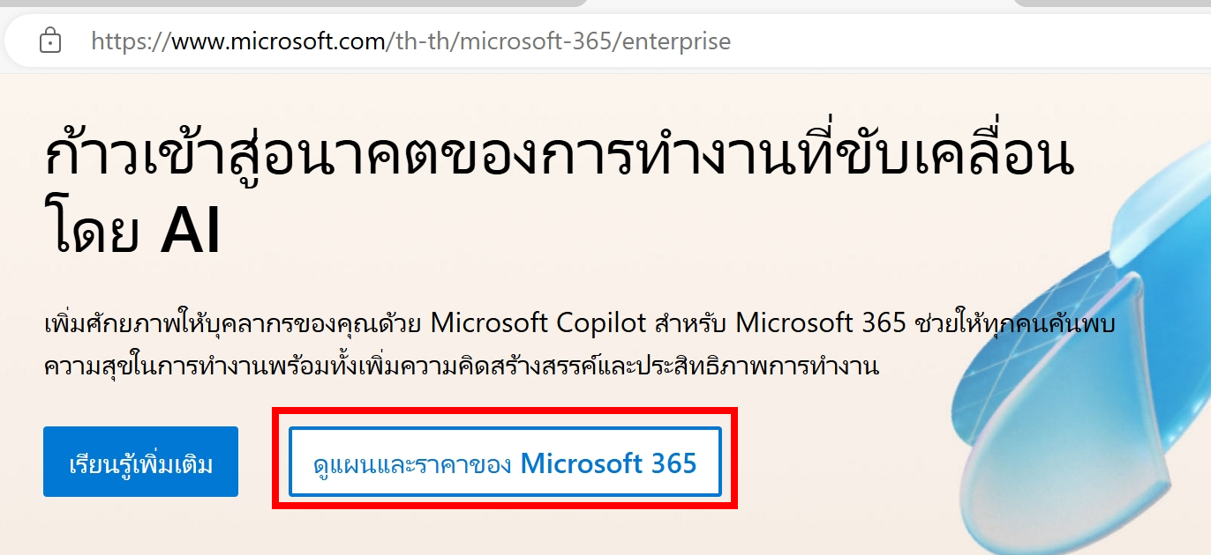
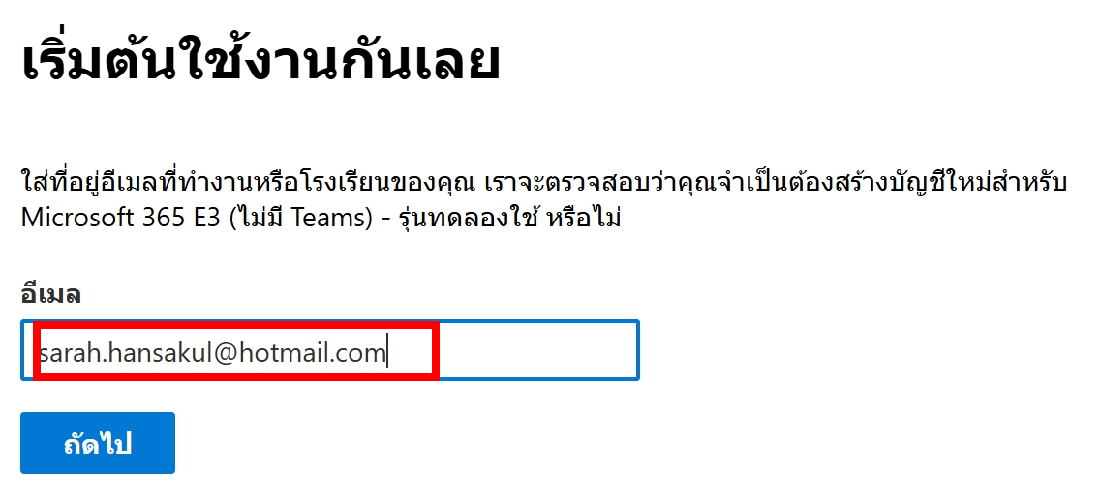
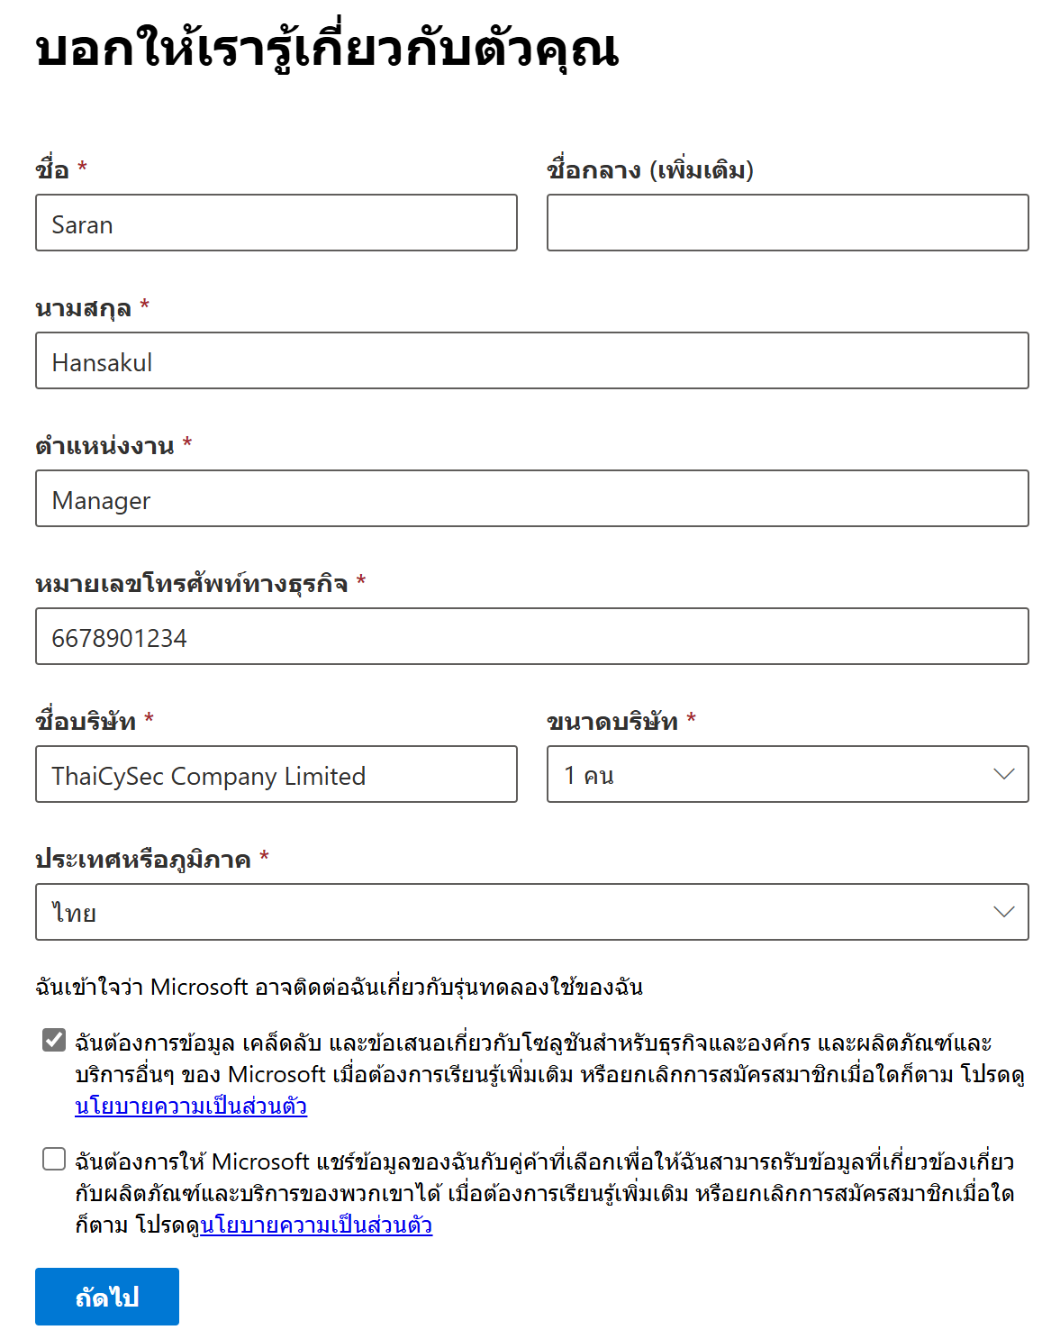
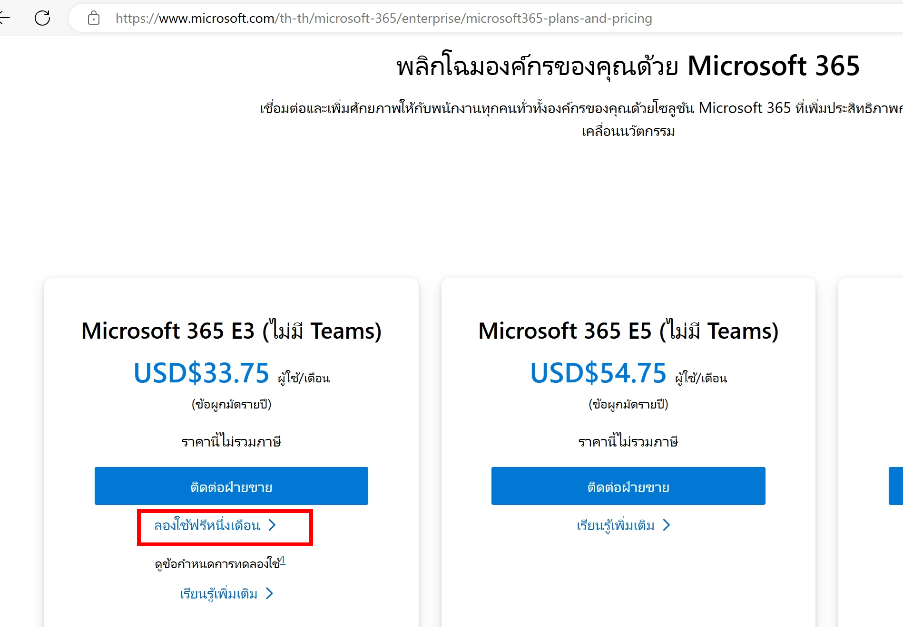
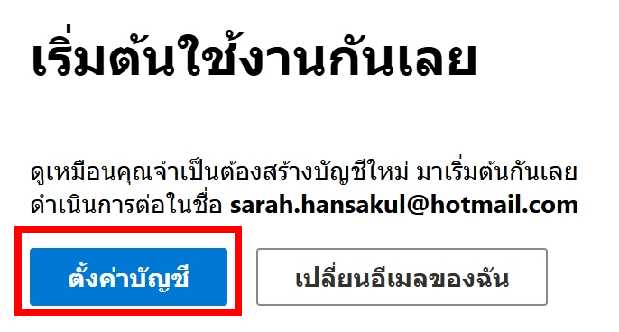
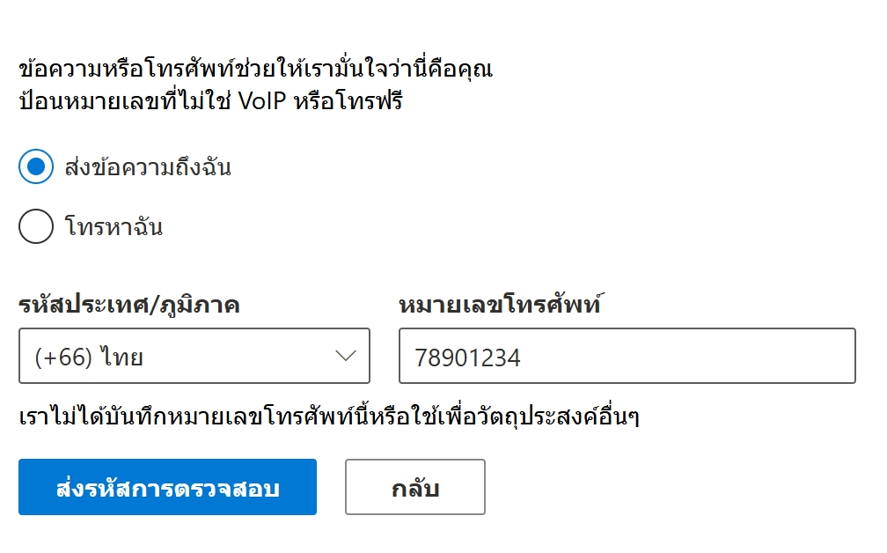
M365
Case II
TRIAL
1mth Trial Account
With Credit Card info
microsoft.com
/microsoft-365/enterprise
Now can use personal domain email
Now can apply only E3 at the best

Slide 16
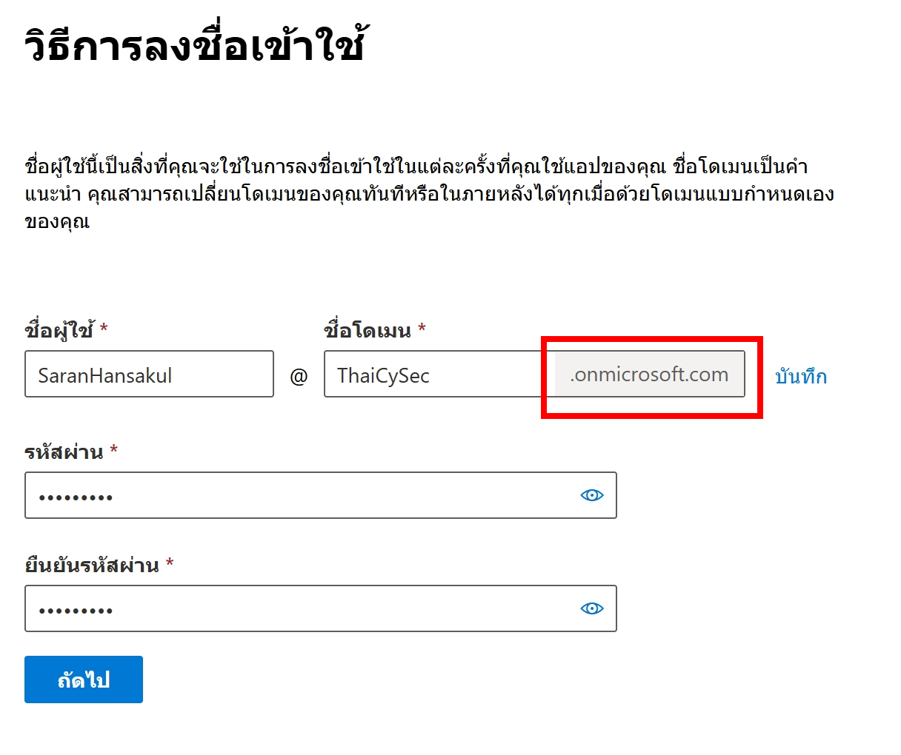
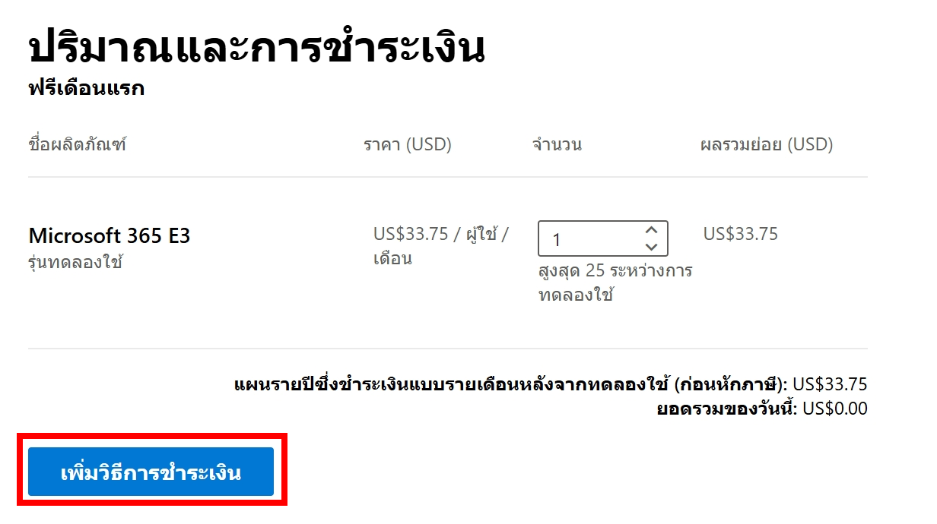
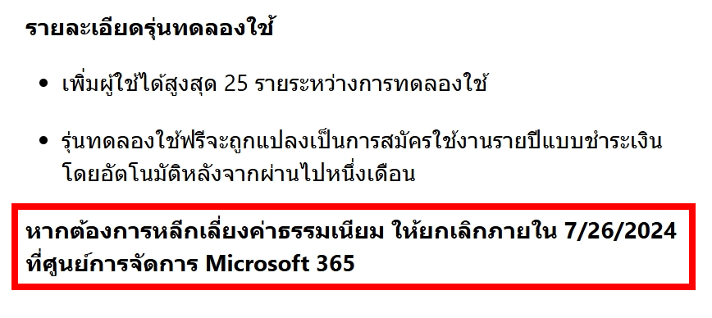
M365
Case II
TRIAL
1mth Trial Account
With Credit Card info
microsoft.com
/microsoft-365/enterprise
Get as primary @xxx.onmicrosoft.com domain
Do not forget to cancel before deadline

Slide 17
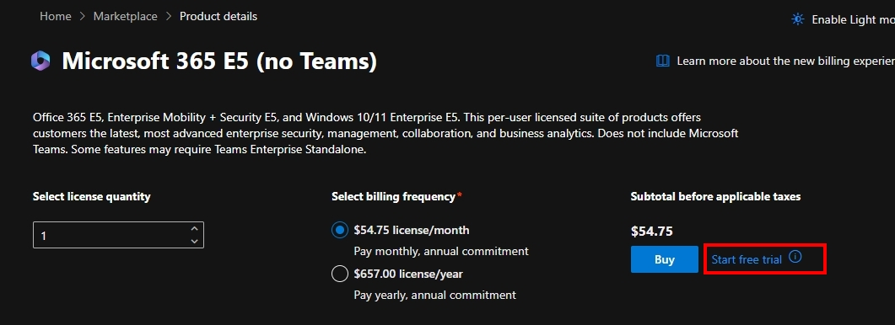
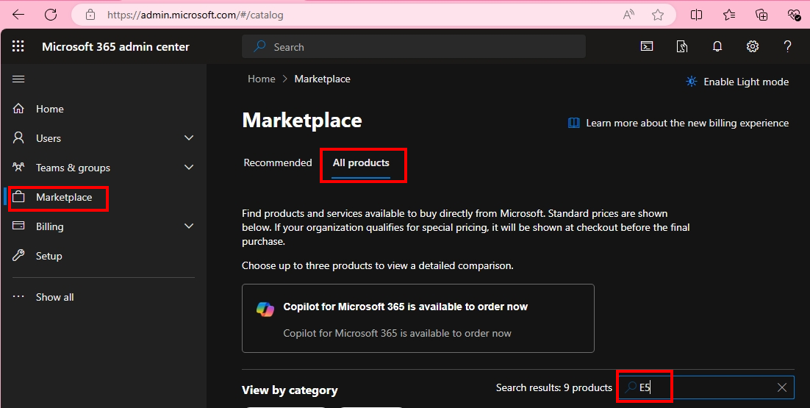
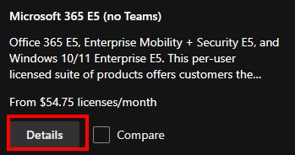
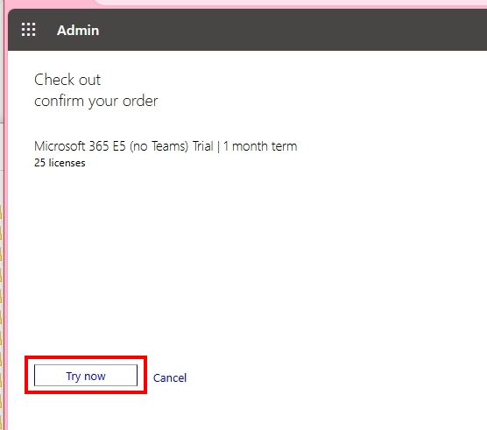
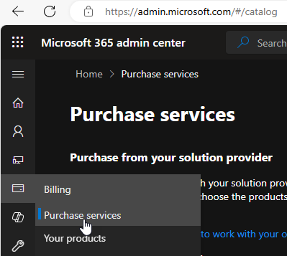
M365
After Get
M365
access
Get E5 Trial via Marketplace
Go to Admin.Microsoft.com
And do not forget to assign lics to users (you, etc.)
Some tenants, Go to Billing > Purchase Services

Slide 18
M365
Fallback Domain
@xxx.onmicrosoft.com
Primary Unique Domain
Fallback if new default domain cannot be used
Can be added more
Use for refer to Partner when buying licenses
Can buy custom domain to add in this tenant
Streamlined / Autosetting with Godaddy.com

Slide 19
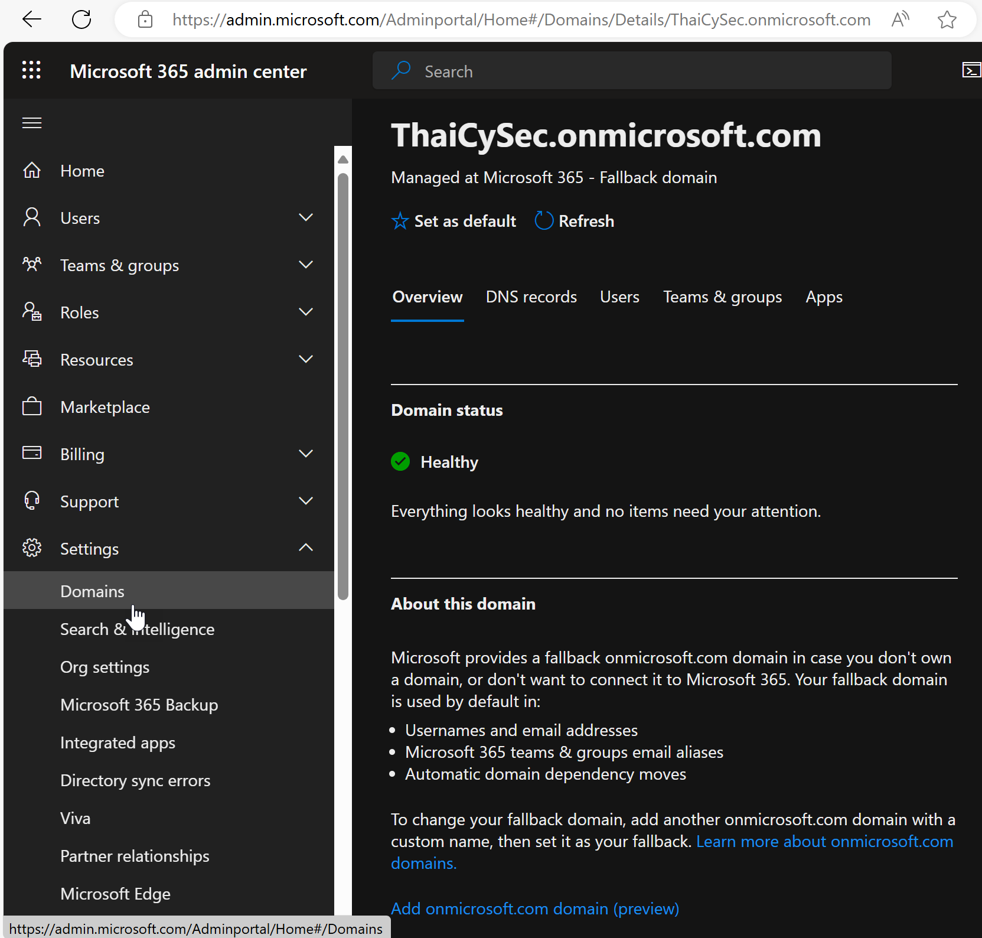
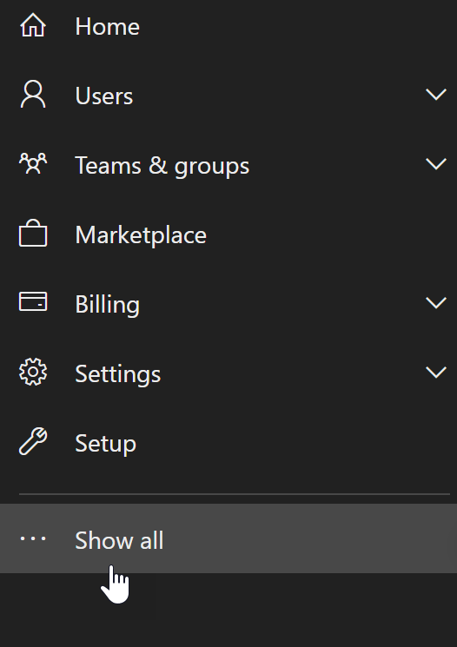
M365
Fallback Domain
Go to Admin.Microsoft.com
Go to Settings > Domains > select onmicrosoft domain
If cannot find “Settings” menu, click “Show all”
Click to add more fallback domain

Slide 20
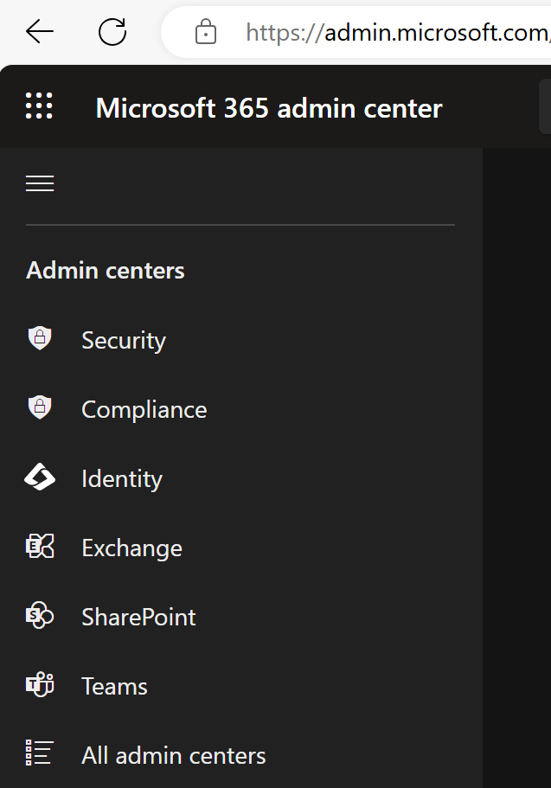
M365
Other Admin Centers
Security.Microsoft.com
Compliance.Microsoft.com = Purview.Microsoft.com
Entra.Microsoft.com

Slide 21
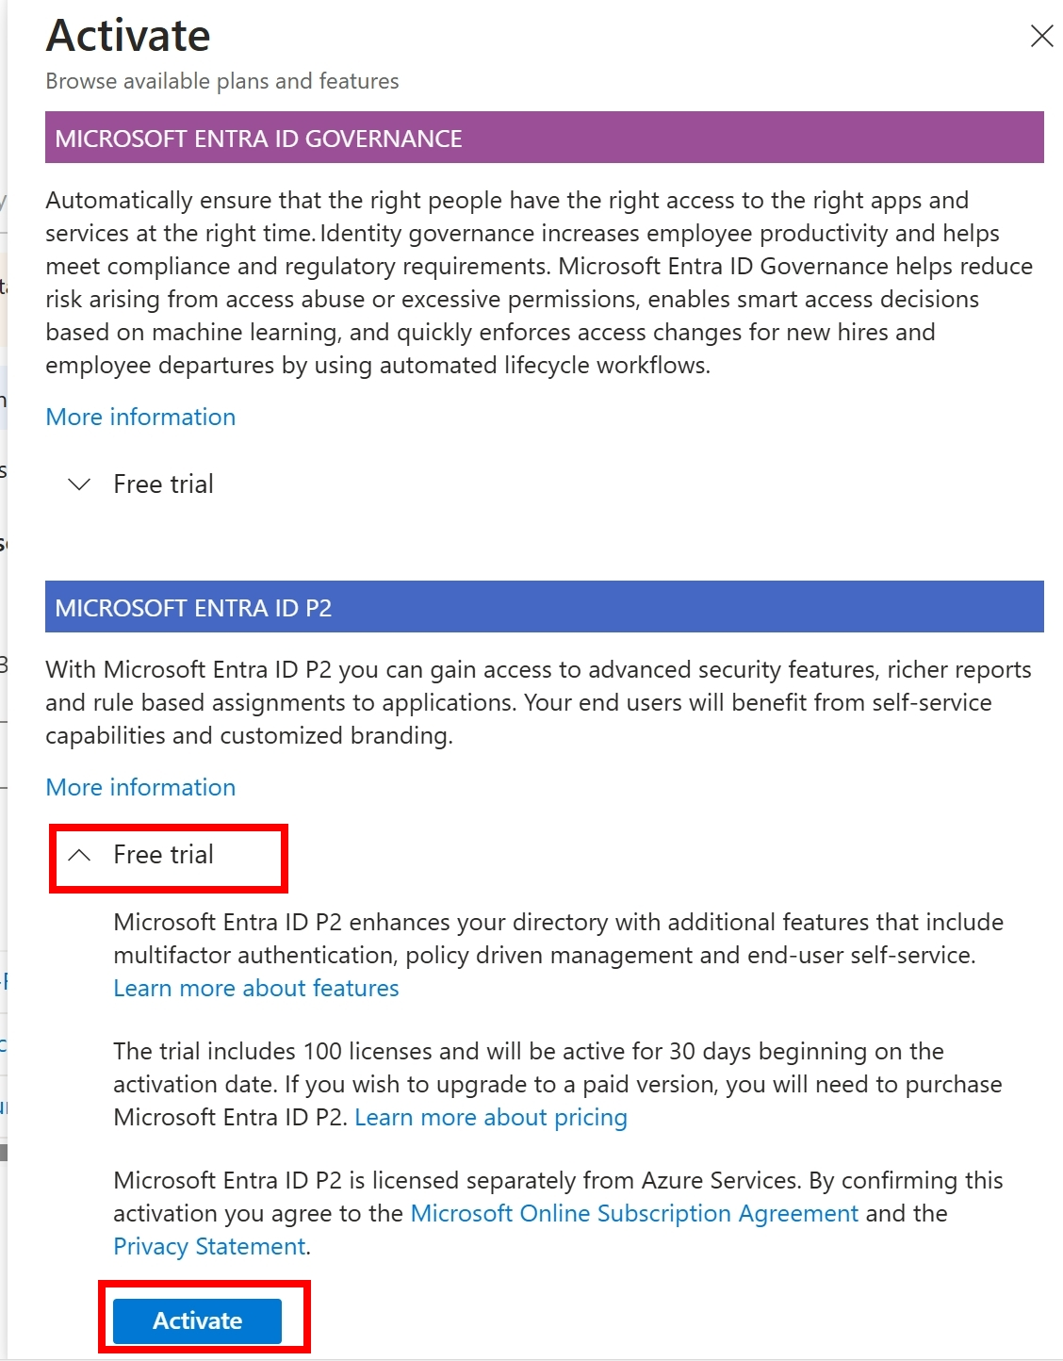
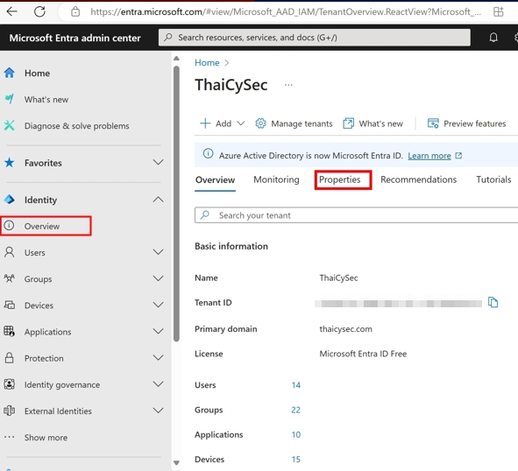
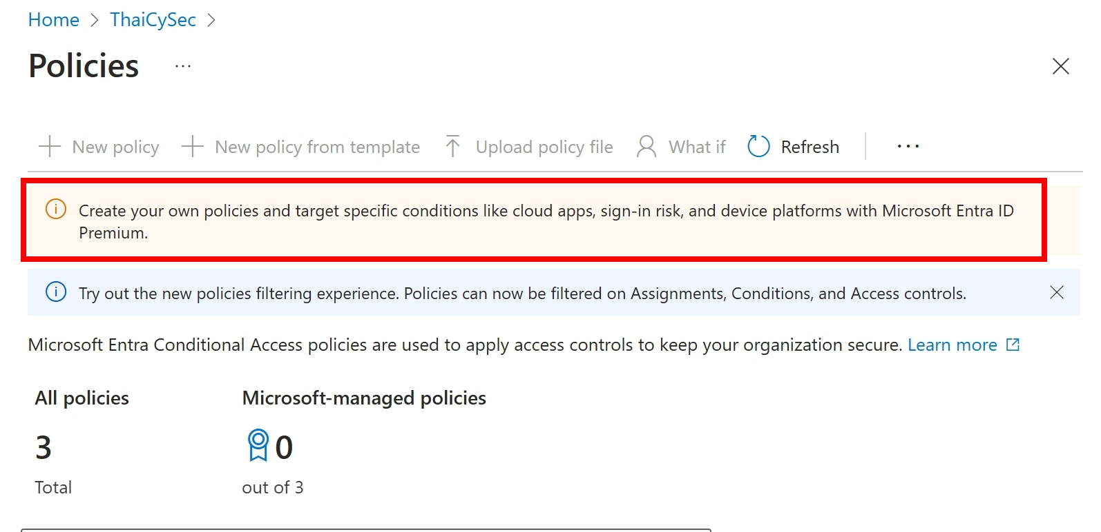
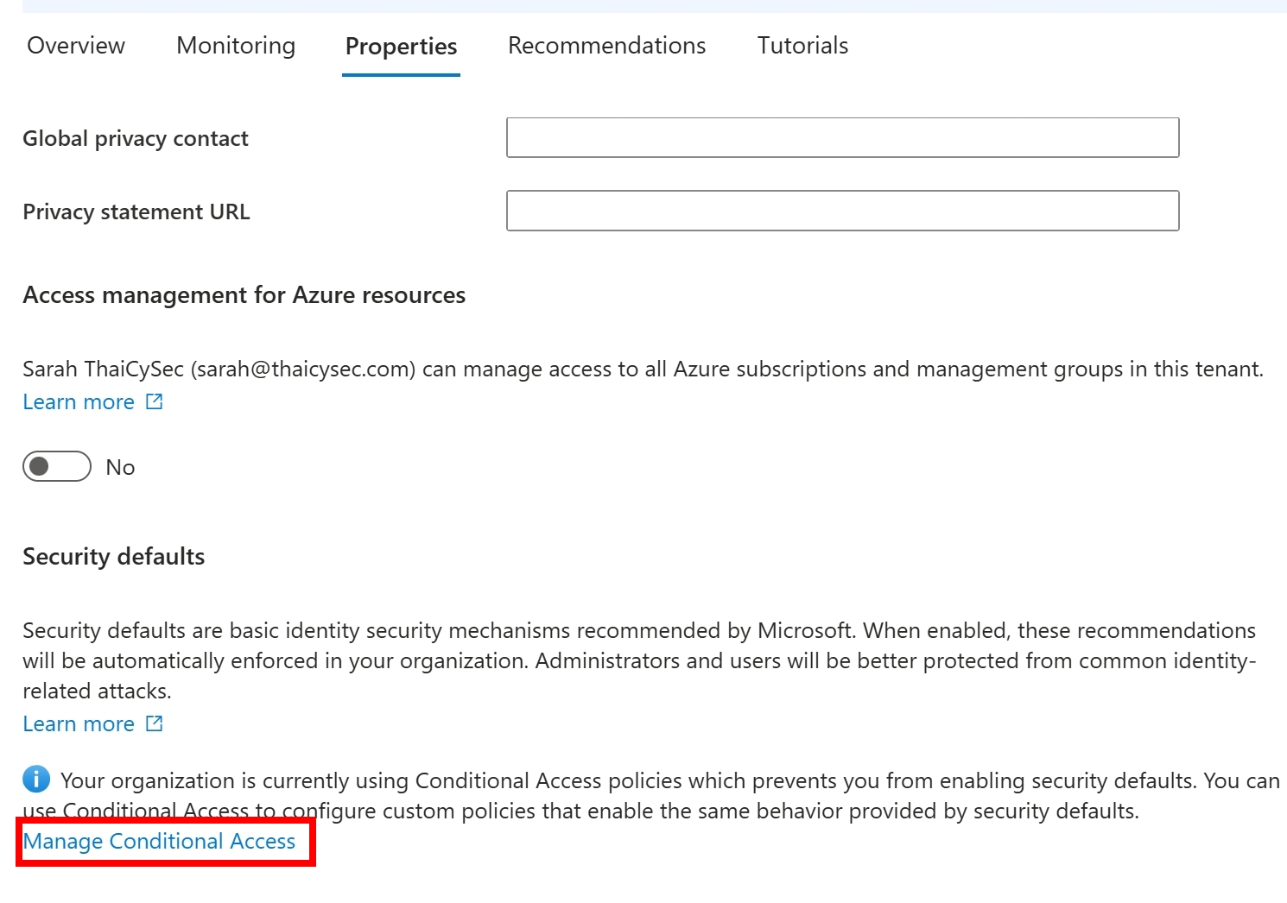
Entra ID
If not
E5
already
P1/P2 Trials
(incl. P2 lic)
Go to Entra.Microsoft.com
Because CA feature need P1, so it has ribbon to redirect to this Trial Activate page
Or you can activate trial via Marketplace of Admin.Microsoft.com
Check if Entra ID License still not
Plan 2

Slide 22
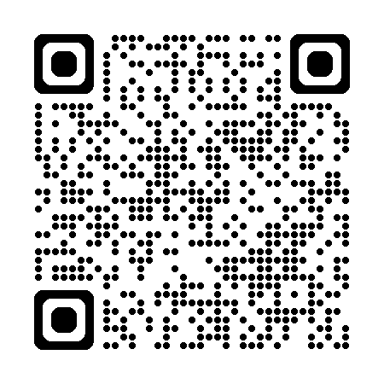
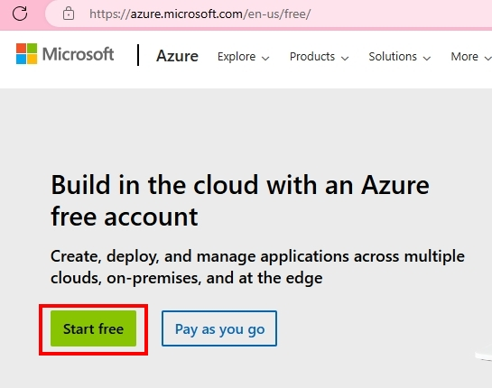
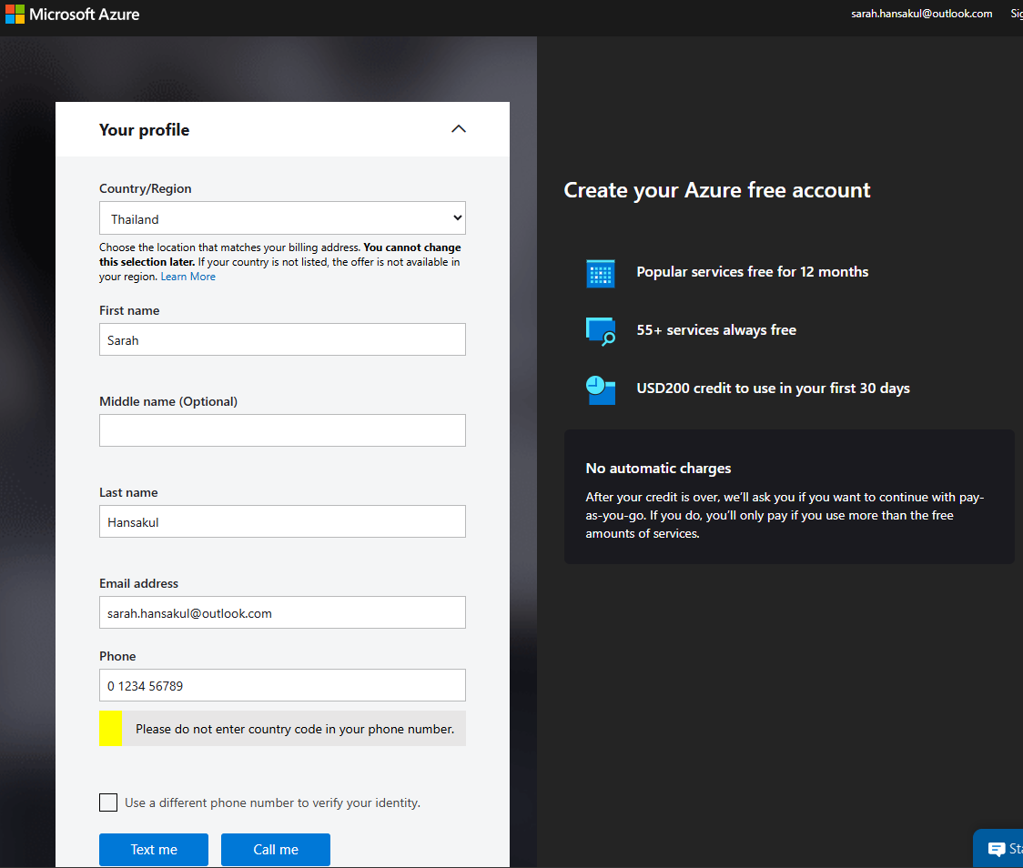
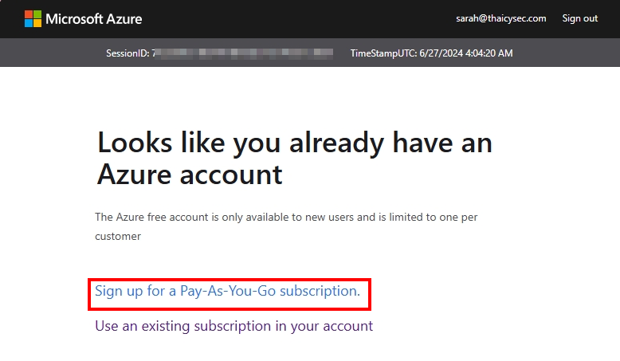
Azure
M365
TENANT
Not Necessary
Free (w/ Credit Card)
Azure.Microsoft.com
/Free
But strongly recommended to use same tenant
If redirected to this page, you must sign up for Pay-as-you-Go instead
Verify phone number first, then enter Credit Card number.

Slide 23
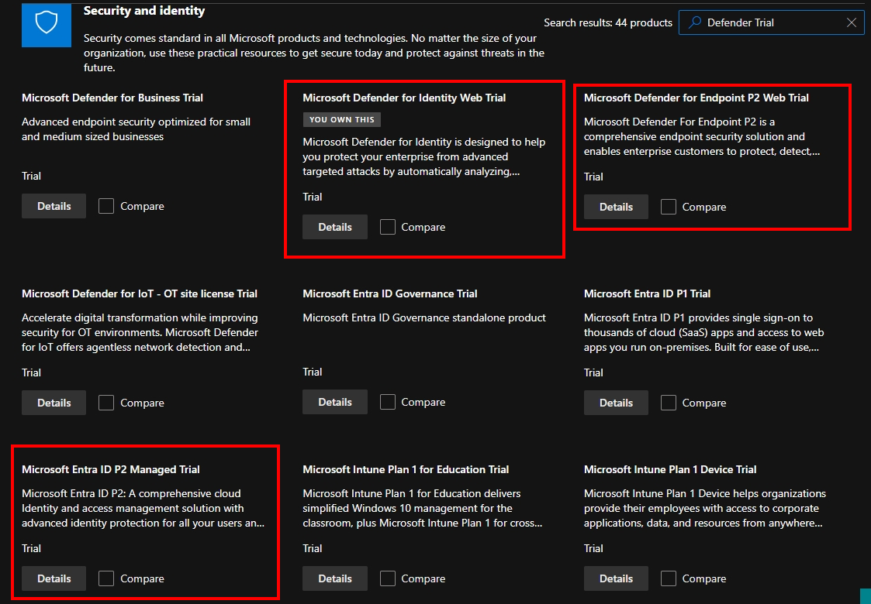
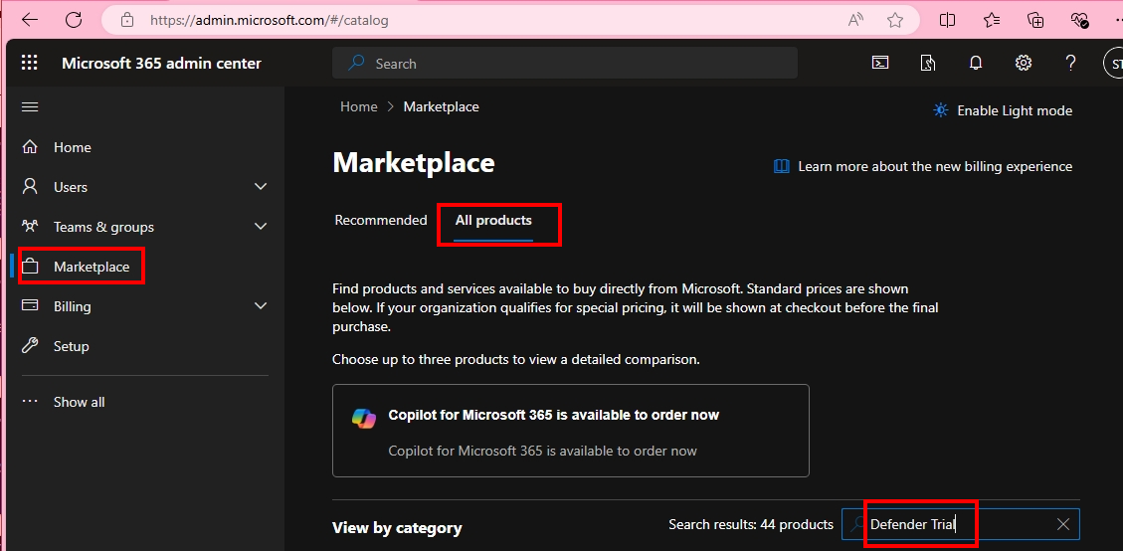
365 Defender
If not
E5
already
Trials: MDE/MDI/MDO/MDCA
(incl. P2 lic)

Slide 24
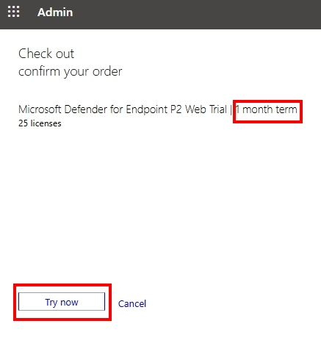



365 Defender
If not
E5
already
Trials: MDE/MDI/MDO/MDCA
(incl. P2 lic)
Do not forget to assign lic to you (User) to use.

Slide 25

365 Defender
If not
E5
already
Trials: MDE/MDI/MDO/MDCA
(incl. P2 lic)

Slide 26

Purview
If not
E5
already
Compliance Trial
But have E3
Go to Compliance.
Microsoft.com

